Slide 1



Three dimensional VOF simulations for wetting of corrugated sheet
Rajesh Singh and Janine Galvin-Carney
National Energy Technology Laboratory
August 9 -10, 2016
NETL 2016 Workshop on Multiphase Flow Science, Morgantown, WV

Slide 2
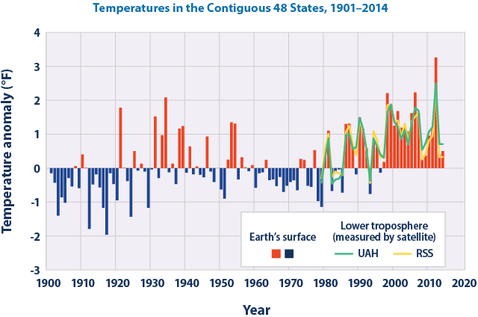
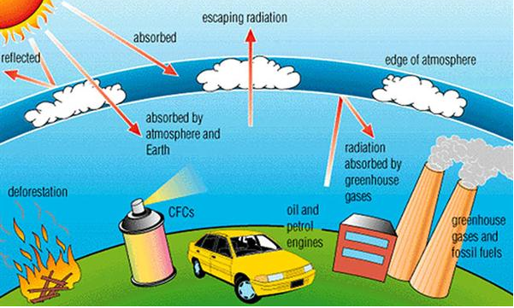
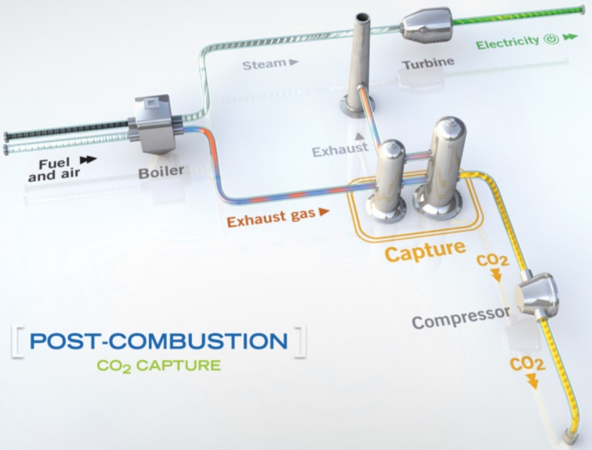
Background and Motivation
CO₂ (72% Globally²)
~40% Emissions²
CO₂ Emissions from power plants needs to be mitigated !!
CO₂ Separation and Capture Technology
Pre-combustion,
Oxy-fuel Combustion,
Membrane Separation,
Post Combustion.
CO₂ Separation and Capture Technology
Pre-combustion,
Oxy-fuel Combustion,
Membrane Separation,
Post Combustion.
More Efficient and Economical
Gaining Widespread Interest.
¹http://www.epa.gov, IEA Report 2008, ³Chu S., Science, 2009, ⁵http://envis.tropmet.res.in, ⁴https://www.globalccsinstitute.com,
Notes:
This figure shows how annual average temperatures in the contiguous 48 states have changed since 1901. Surface data come from land-based weather stations. Satellite measurements cover the lower troposphere, which is the lowest level of the Earth’s atmosphere. “UAH” and “RSS” represent two different methods of analyzing the original satellite measurements. This graph uses the 1901–2000 average as a baseline for depicting change. Choosing a different baseline period would not change the shape of the data over time.

Slide 3
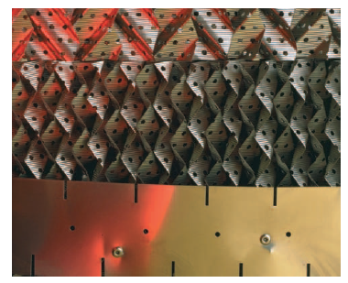
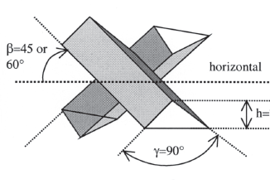
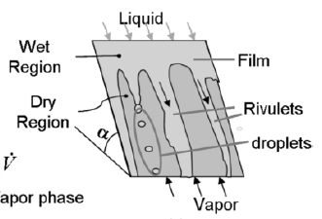
CFD Modeling of Solvent Absorption
Purified
Gas
Column²:
Φ ~10m
H ~30m
CO₂ absorption depends on
hydrodynamics of global & local flow
Lean Solvent
Layer height²:
~20cm
Challenges:
Cannot model entire column focusing in on all physical phenomenon
Multi-scale approach required
TFM lacks suitable closure models for interphase interactions
Column²:
Φ ~10m
H ~30m
Corrugation height²:
O(mm)
Flue Gas
to Stripper
Rich Solvent
film thickness²
~ O(0.1mm)
Study the hydrodynamics of rivulet flow over corrugated sheet
Source⁴
Notes:
Interactive parallel FLUENT simulation on ‘Joule’ Supercomputer

Slide 4
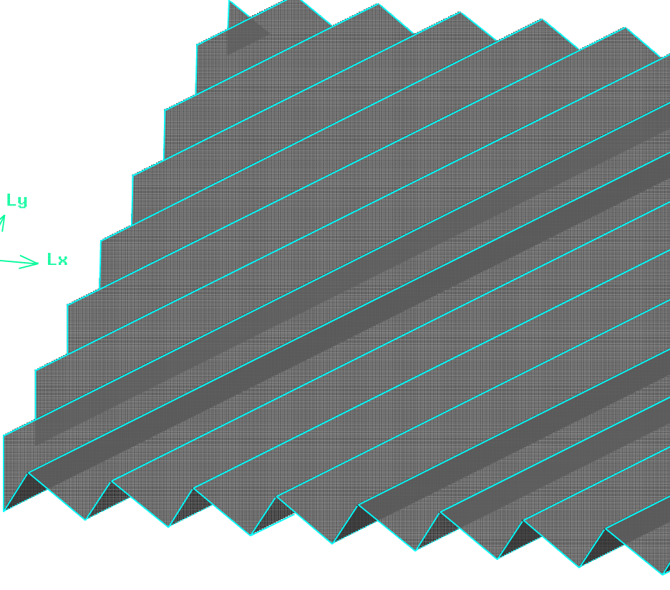
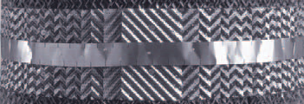
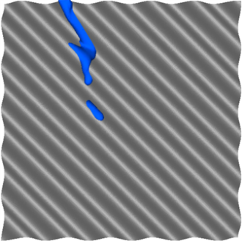
Problem Setup
FLEXIPAC Packing
(Representation)
Sheets: arranged vertical & perpendicular to each other
s
h
α
Simulation
setup
θ
B
Design Parameters of the Sheet
Corrugation angle (α) | 45°
Crimp Angle (θ) | 45°
Corrugation base (B) | 18 mm
Corrugation height (h) | 9 mm
Corrugation side (s) | 12.73 mm
Frontal size | 100×100 mm²
100 mm
Rivulet flow over vertical
corrugated sheet
100 mm

Slide 5
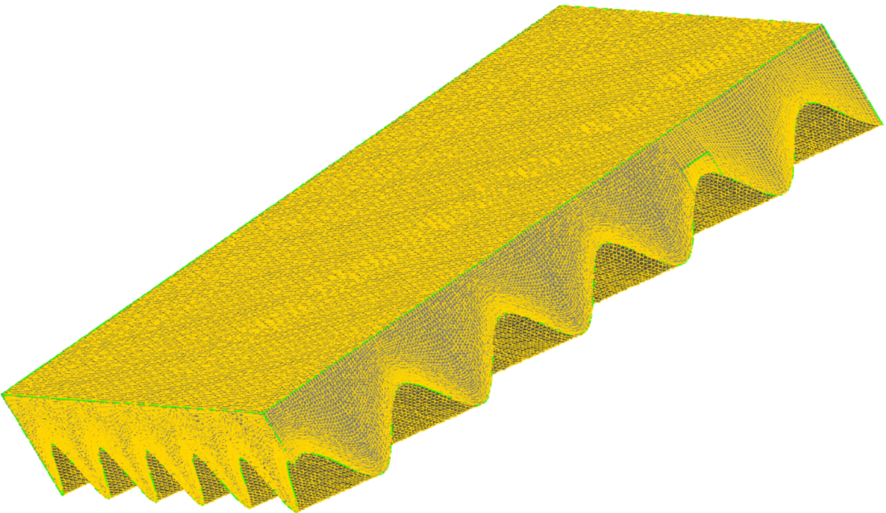
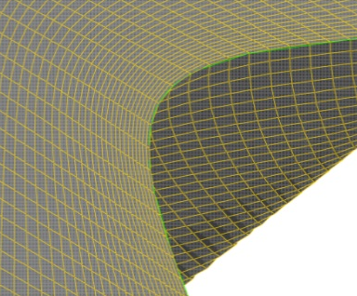


VOF Method and Meshing
Governing Equations
– Continuity and momentum equation of average phase
– Transport equation for volume fraction
Force at interface due to Interfacial tension
Challenges:
Very fine mesh required; higher corrugation angles require even finer mesh
Mesh: 2.0 − 3.9 M
Very fine time steps
Time step:
$$Δt:10^{−7}−10^{−4}$$
Initially with $Δt=10^{−7}$

Slide 6
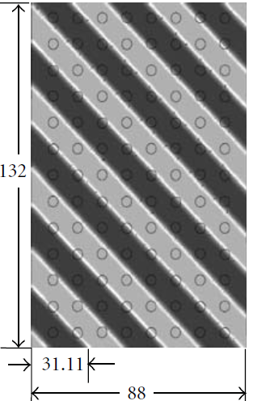
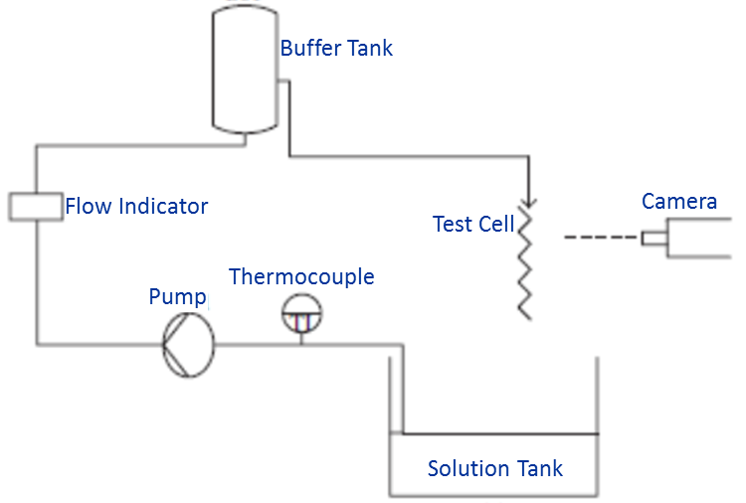
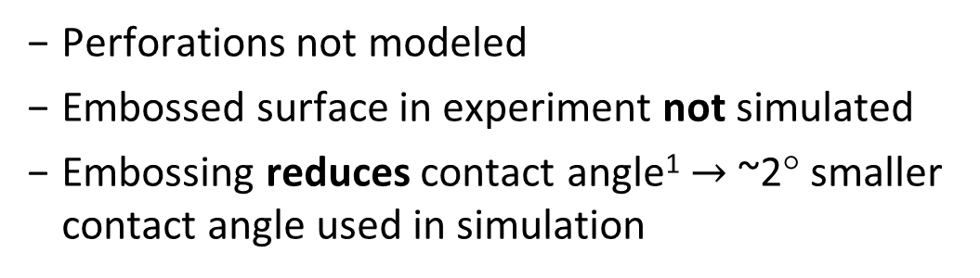
Validation with Experiments
(Subramanian & Wozny, IJCE, 2012, 838965)
Simulation conducted
only in this region
Perforations not modeled
Embossed surface in experiment not simulated
Embossing reduces contact angle¹ $→$~2° smaller contact angle used in simulation
All dimensions are in mm
Corrugation angle: 45°
¹Nicolaiewsky & Fair, IECR, 1998. 38: 284-291.
Notes:
Gunter Wozny, Technische Universität Berlin, Berlin
Embossed sheet

Slide 7
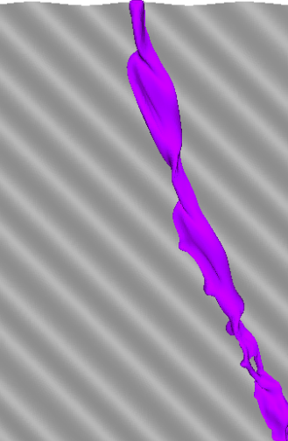
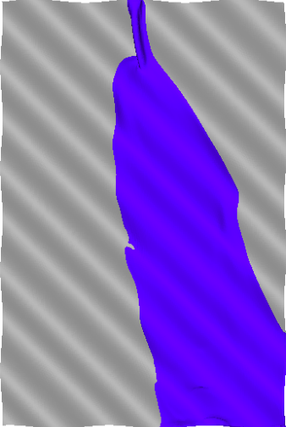
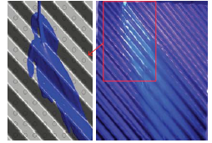
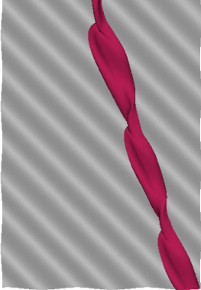
Validation with Experiments
Physical Properties of Liquids
Solvent | μ_{l} (mPa-s) | ρ_{l} (kg/m³) | σ_{l} (mN/m) | γ (°)
Water | 1 | 997 | 72.7 | 76.6
Water-Glycerol | 4.6 | 1113 | 70 | 69
Silicon Oil | 4.6 | 915 | 18.5 | ≈7
Exp
Water
(386 mlpm)
CFD
Present
S&W
Good agreement with experiments
Exp
Exp
Present
S&W
Present
S&W
Exp
CCSI
Silicon Oil (241 mlpm)
Glycerol/Water (387 mlpm)

Slide 8
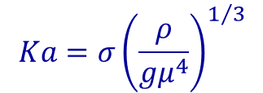
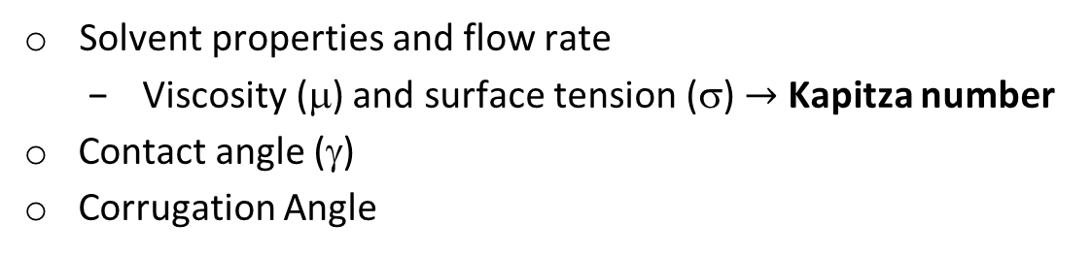
Factors Affecting Film/Rivulet Flows
Depends on various parameters
Solvent properties and flow rate
Viscosity (μ) and surface tension (σ) $→$ Kapitza number
Contact angle (γ)
Corrugation Angle
Solvent Properties
Solvent | μ_{l} (Pa-s) | ρ_{l} (kg/m³) | σ_{l} (N/m) | Ka
Water | 0.00089 | 997.0 | 0.07280 | 3969
30% MEA¹ | 0.00252 | 1013.0 | 0.05480 | 750
40% MEA¹ | 0.00371 | 1015.3 | 0.05500 | 450
0.07m MPZ² | 0.00556 | 1005.3 | 0.05442 | 258
48.8% MDEA³ | 0.00925 | 1016.6 | 0.04756 | 117
0.51m MPZ² | 0.01336 | 946.41 | 0.03437 | 50
0.41m MPZ² | 0.02348 | 962.2 | 0.03589 | 25
0.31m MPZ² | 0.03642 | 981.31 | 0.03840 | 15
Kapitza number (Ka)
$$Ka={σ\left(\frac{ρ}{{gμ}^{4}}\right)}^{1/3}$$
Only depends on fluid properties
Independent of flow rate
¹Maham, et al., Thermochimica Acta, 2002. 386: 111-118; ²Rayer, et al., J. Chem. Thermodynamics, 2011. 43: 1897-1905; ³Muhammad, et al., J. Chem & Engg. Data, 2008. 53: 2226-2229

Slide 9
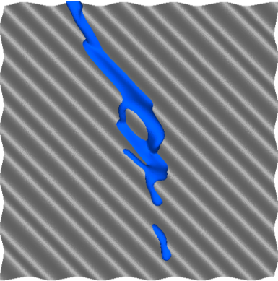
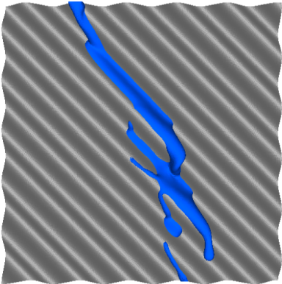
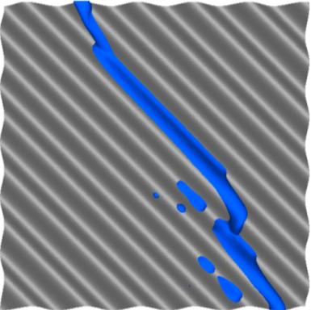
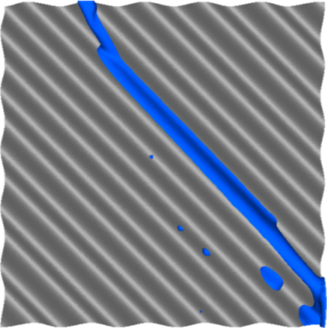
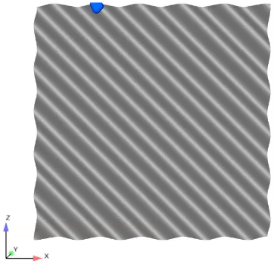
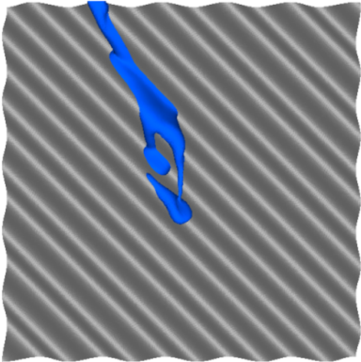
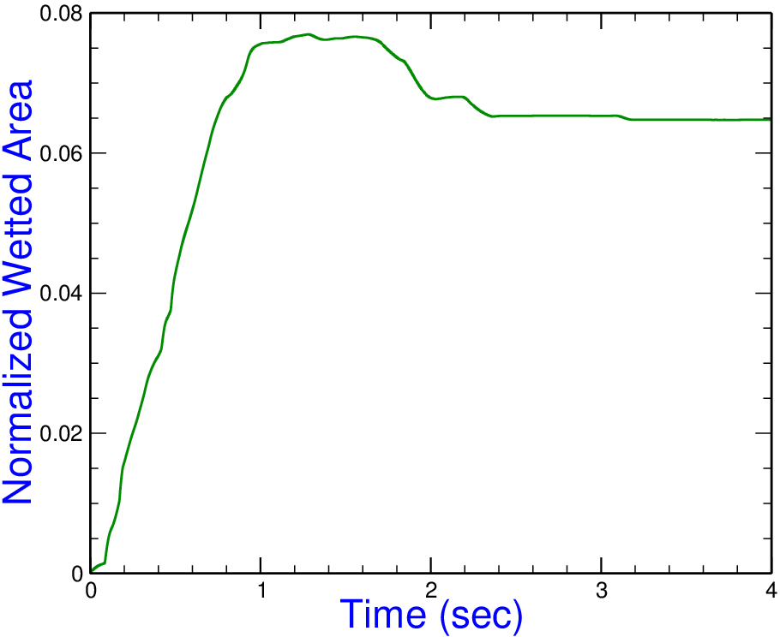
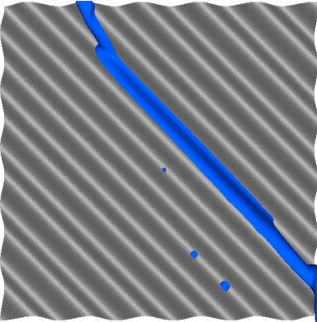
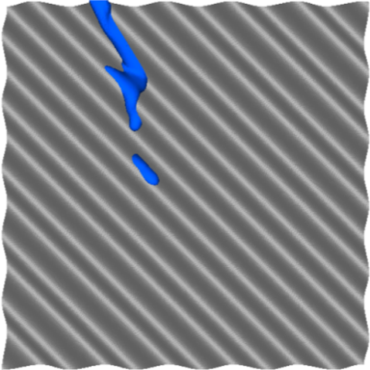
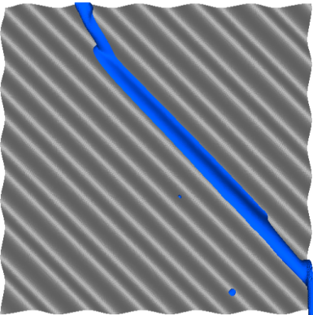

Temporal Gas-Liquid Interface (31MPZ)
$$Q=2.01×10^{−6} m^{3}/sec$$
0.62
0.81
1.23
1.89
0.43
2.55
pseudo-steady state: flow channeling
0.21
3.83

Slide 10
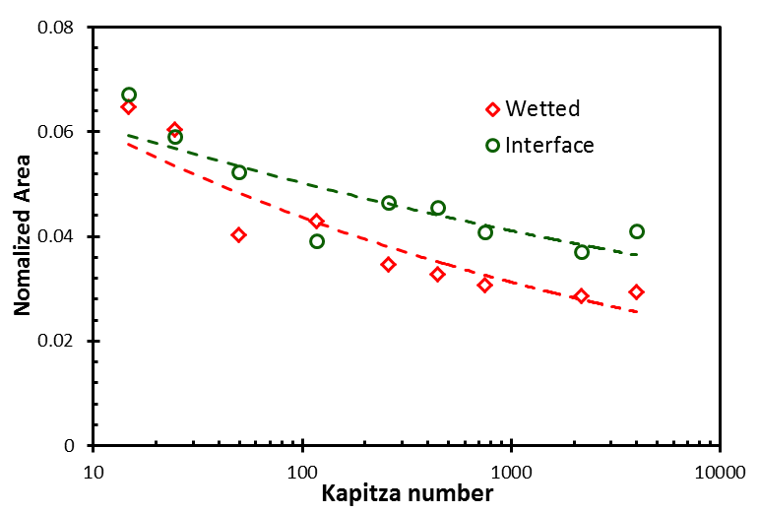
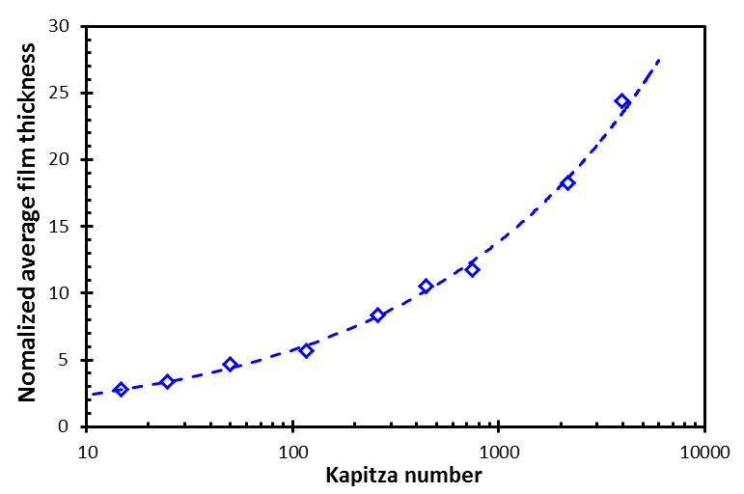



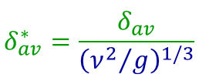

Effects of Solvent Properties
$$Q=2.01×10^{−6} m^{3}/sec and γ=70°$$
$$δ_{av}= \frac{Entrained volume of Solvent}{Wetted Area}$$
$$Normalized Area=\frac{ Area}{Sheet Area }$$
$$δ_{av}^{∗}=\frac{δ_{av}}{{\left({ν^{2}}/g\right)}^{1/3}}$$
= viscous length scale
Increasing $μ \text{value}$
Increasing $μ \text{value}$
Interfacial and wetted areas decrease
Normalized film thickness increases BUT absolute value decreases

Slide 11
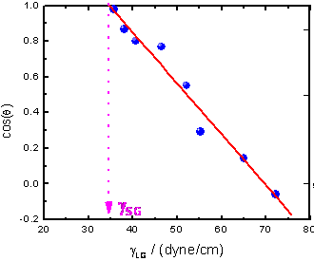

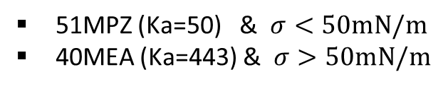

Effects of Contact Angle (γ)
Contact angle:
A liquid exhibits different γ with different solids
water and steel: γ=70°
water and Plexiglas: γ= 81°
Roughness of the surface
Value of contact angle inherently depends on surface tension
A liquid with small σ typically shows lower γ
Two solvents representative of each regime
Increasing $γ \text{value}$
51MPZ (Ka=50) & $σ<50mN/m$
40MEA (Ka=443) & $σ>50mN/m$
$$cos⁡(γ)$$
Zisman Plot
Surface Tension (dyne/cm)

Slide 12
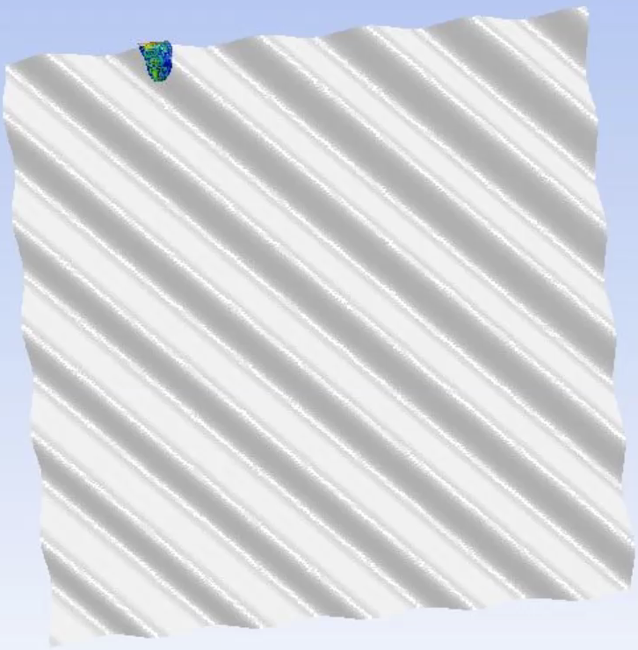
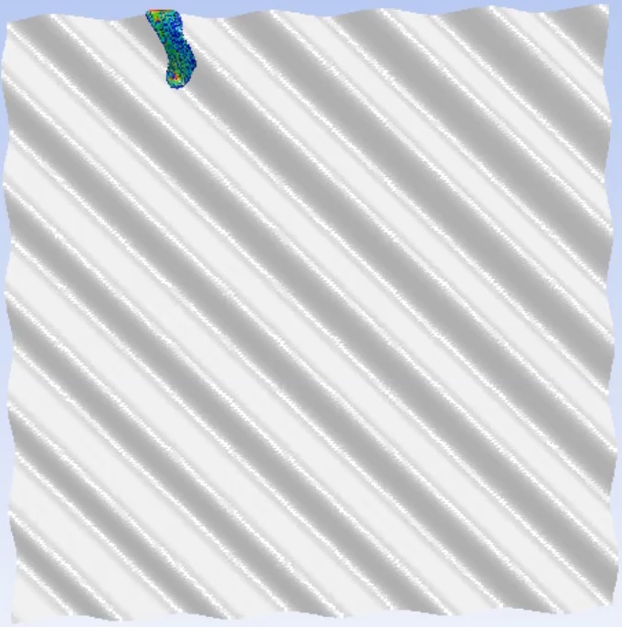
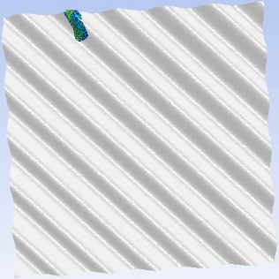

Effects of Contact Angle (γ): 51MPZ (Ka=50)
$$Q=2.01×{10}^{−6}m^{3}/sec$$
Contact Angle= 80°
Contact Angle= 50°
Contact Angle= 20°
Decreasing Contact Angle (γ)
Interfacial area increases

Slide 13
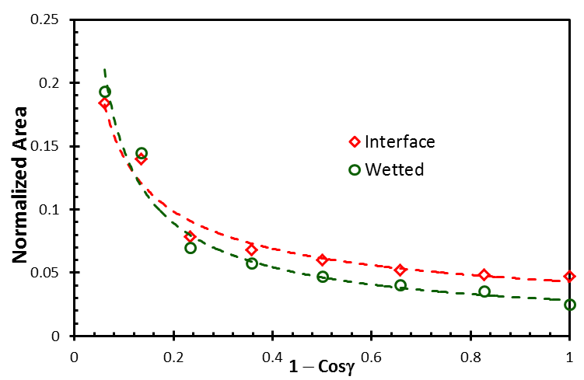
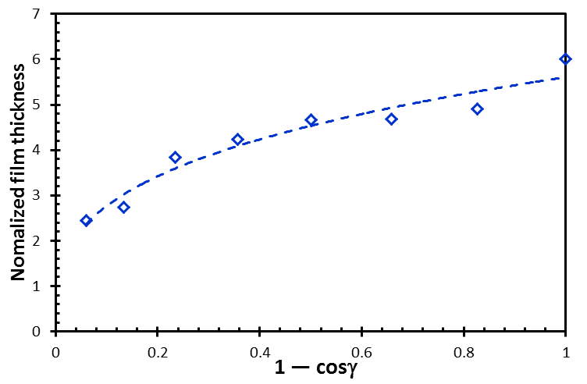



Effects of Contact Angle (γ): 51MPZ (Ka=50)
$$Q=2.01×10^{−6} m^{3}/sec$$
Wetted & Interfacial Area
Film Thickness
Increasing $γ \text{value}$
Increasing $γ \text{value}$
Increasing contact angle (γ):
Wetted and interfacial areas decrease
Film thickness increases

Slide 14
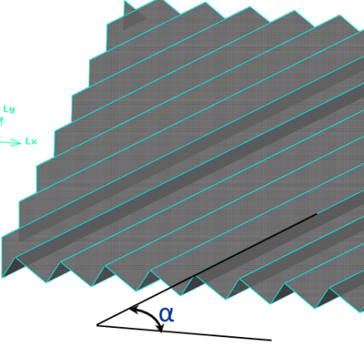
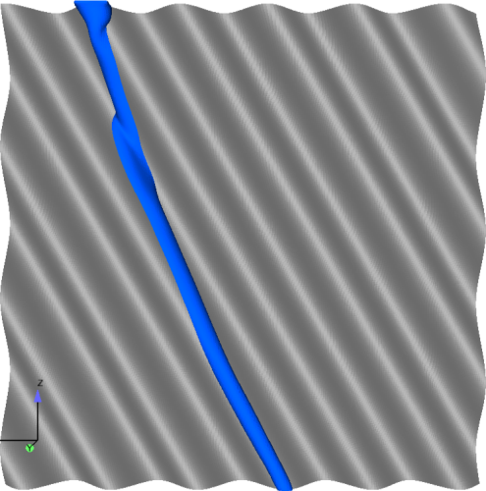
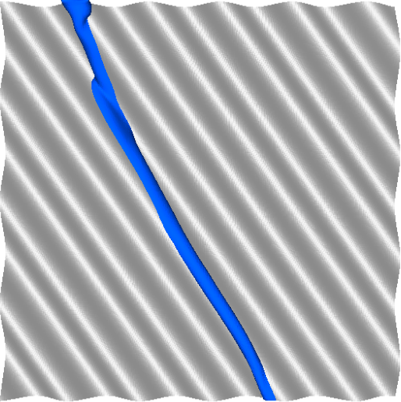
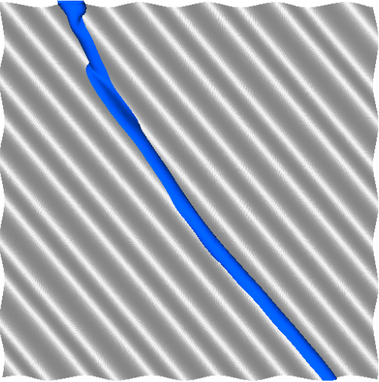
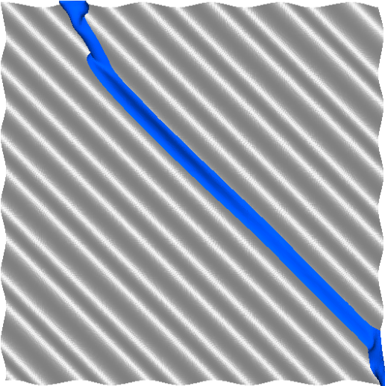
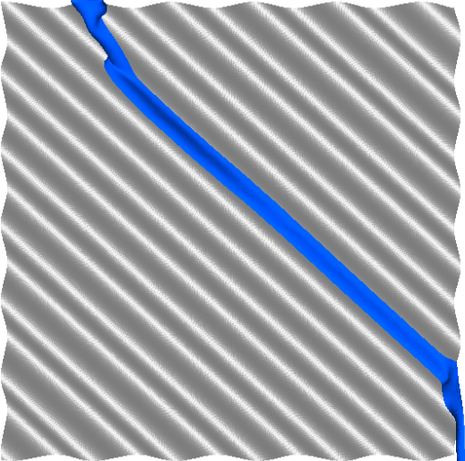
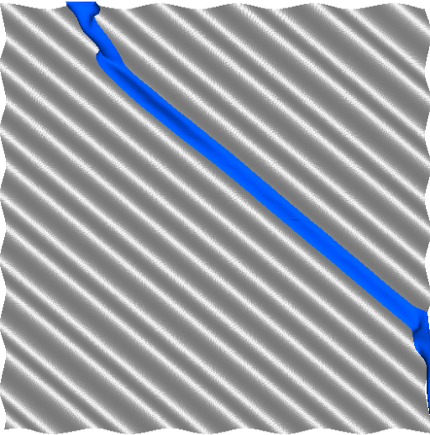
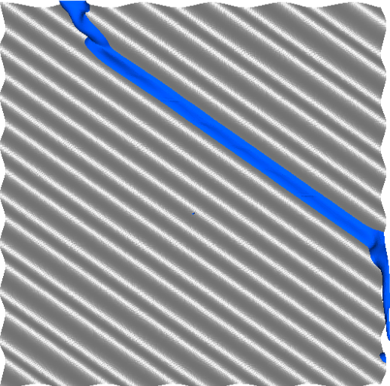


Effects of Corrugation Angle (α): 51MPZ (Ka=50)
$$Q=2.0×10^{−6} m^{3}/sec$$
For fixed contact angle: $γ=70°$
Corrugation angle
α= 30°
α= 35°
α= 40°
s
h
α
θ
B
α= 45°
α= 47.5°
α= 50°
α= 55°

Slide 15
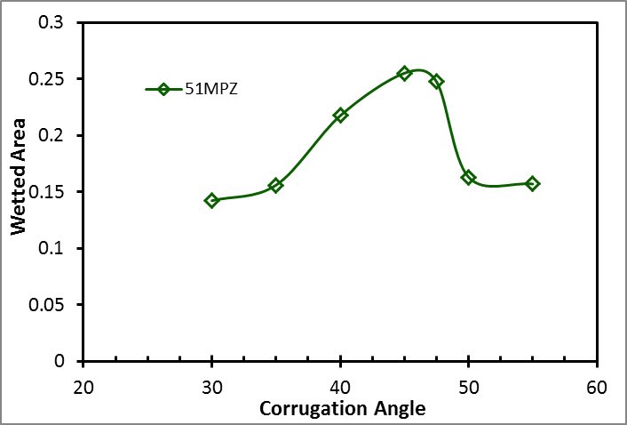
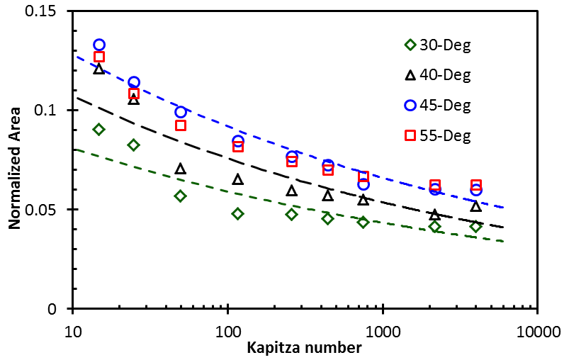






Effects of Corrugation Angle (α)
$$Q=2×{10}^{−6}m^{3}/sec$$
$$γ=30°$$
$$γ=70°$$
$$γ=70°$$
50
450
only 51MPZ simulated
3969
51MPZ has a smaller surface tension ($σ=34.37mN/m$) and therefore may exhibit smaller contact angles ($γ$)
Wetted area shows non-monotonic variation
Optimum corrugation angle: 45°

Slide 16



Conclusion
VOF simulations used to explore rivulet flow over corrugated sheet
Good agreement between experiments and VOF simulations
Results presented in terms of the Kapitza number: $Ka=σ{{(ρ_{l}}/{gμ_{l}^{4})}}^{1/3}$
Scaling relations for interfacial and wetted areas
Solvent properties, flow rate and contact angle
Interfacial area of rivulet
decreases with increased Ka
decreases with increased γ
Corrugation angle
Non-monotonic variation of wetted area
Optimum corrugation angle: 45°
contact angle $(γ)=30°$

Slide 17
Acknowledgments
Carbon Capture Simulation Initiative (CCSI)
NETL Supercomputer ‘Joule’
CCSI Task 3&4 Team
Disclaimer: This work is made available by an agency of the United States Government. Neither the United States Government, the Department of Energy, the National Energy Technology Laboratory, nor any of their employees, makes any warranty, express or implied, including warranties of merchantability and fitness for a particular purpose, or assumes any legal liability or responsibility for the accuracy, completeness, or usefulness of any information, apparatus, product, or process disclosed, or represents that its use would not infringe privately owned rights. Reference herein to any specific commercial product, process, or service by trade name, trademark, manufacturer, or otherwise, does not necessarily constitute or imply its endorsement, recommendation, or favor by the United States Government, the Department of Energy, or the National Energy Technology Laboratory. The views and opinions of authors expressed herein do not necessarily state or reflect those of the United States Government, the Department of Energy, or the National Energy Technology Laboratory, and shall not be used for advertising or product endorsement purposes.

Slide 19




Effect of Solvent Flow Rate (Q)
Solvent: 40MEA
(Ka=443)
$$μ=3.705 mPaS$$
$$σ=54.8 mN/m$$
$$ρ=979 kg/m^{3}$$
$$Re=\frac{ρu_{in}D_{H}}{μ}$$
D_{H} = hydraulic diameter of inlet
Wetted & Interfacial Area
Film Thickness
Interfacial area and film thickness increase with increased flow rate

Slide 20








Effects of Contact Angle: 51MPZ (Ka=50)
$$Q=2.01×{10}^{−6}m^{3}/sec$$
Snapshots of interface:
$$(f=0.50)$$
γ= 20°
γ= 30°
γ= 40°
Increasing Contact Angle
γ= 50°
γ= 70°
γ= 90°
Interfacial area decreases

Slide 21



Interfacial and Wetted Area: 40MEA (Ka=448)
$$Q=2.01×10^{−6} m^{3}/sec$$
Wetted & Interfacial Area
Film Thickness
Increasing $γ \text{value}$
Increasing $γ \text{value}$
Increased contact angle (γ):
Wetted and interfacial areas decrease
Film thickness increased

Slide 22





Effects of Corrugation Angle (α)
Area of sheet with corrugation angle
$$Normalized Physcial Area=\frac{Actual Area}{Frontal Area }$$
$$Frontal Area=L×W$$
W
L
Actual area
increased corrugation angle $→$ enhanced sheet area

Slide 23




Effects of Corrugation Angle (α)
$$Q=2×{10}^{−6}m^{3}/sec and γ=70°$$
$$Normalized Interfacial Area=\frac{Interfacial Area}{Frontal Area }$$
$$Normalized Wetted Area=\frac{Wetted Area}{Frontal Area }$$
Wetted Area
Film Thickness
wetted area shows non-monotonic variation
film thickness unchanged

Slide 24









Effects of Corrugation Angle (α) : 51MPZ (Ka=50)
$$Q=2.0×10^{−6} m^{3}/sec$$
For fixed contact angle: $γ=30°$
α= 30°
α= 35°
α= 40°
α= 45°
α= 47.5°
α= 50°
α= 55°
Non-monotonic variation of wetted area

